Slide 1
IP Addressing
Notes:
Cisco Networking Academy program
Introduction to Networks
Chapter 8: IP Addressing

Slide 2
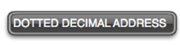
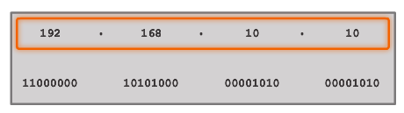
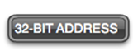
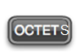
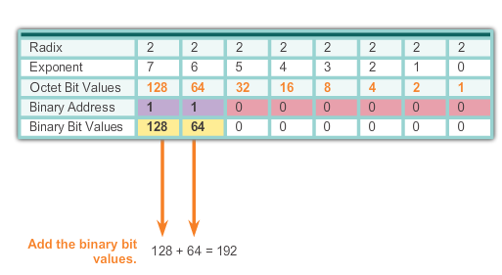
IPv4 Address Structure Binary Number System
Notes:
8.1.1.2 Binary Number System

Slide 3
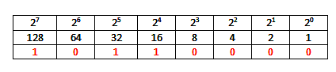
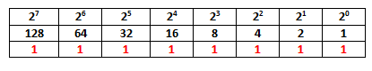
IPv4 Address Structure Converting a Binary Address to Decimal
Practice
Notes:
8.1.1.3 Converting a Binary Address to Decimal

Slide 4
IPv4 Address Structure Converting a Binary Address to Decimal
Practice
Answer = 176
Answer = 255
Notes:
8.1.1.3 Converting a Binary Address to Decimal

Slide 5
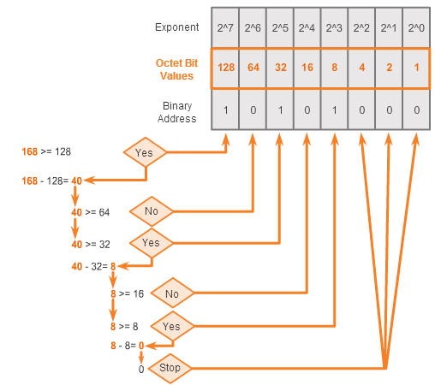
IPv4 Address Structure Converting from Decimal to Binary
168 = ? binary
Notes:
8.1.1.5 Converting from Decimal to Binary

Slide 6
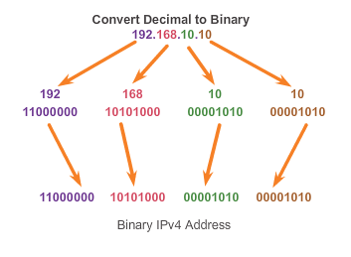
IPv4 Address Structure Converting from Decimal to Binary (Cont.)
Notes:
8.1.1.6 Converting from Decimal to Binary (Cont.)

Slide 7
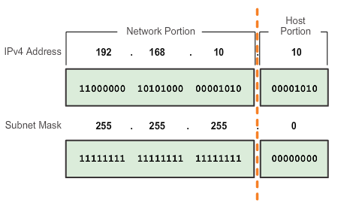
IPv4 Subnet Mask Network Portion and Host Portion of an IPv4 Address
To define the network and host portions of an address, a devices use a separate 32-bit pattern called a subnet mask
The subnet mask does not actually contain the network or host portion of an IPv4 address, it just says where to look for these portions in a given IPv4 address
Notes:
8.1.2.1 Network Portion and Host Portion of an IPv4 Address

Slide 8
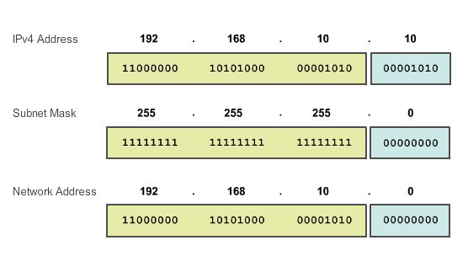
IPv4 Subnet Mask Bitwise AND Operation
1 AND 1 = 1 1 AND 0 = 0 0 AND 1 = 0 0 AND 0 = 0
Notes:
8.1.2.5 and 8.1.2.6 Bitwise AND Operation/Importance of ANDing

Slide 9
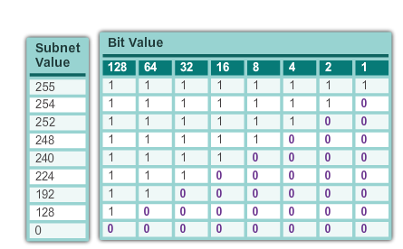
IPv4 Subnet Mask Network Portion and Host Portion of an IPv4 Address (cont.)
Valid Subnet Masks
Notes:
8.1.2.1 Network Portion and Host Portion of an IPv4 Address (cont.)

Slide 10
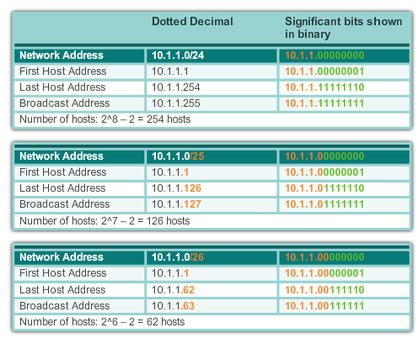
IPv4 Subnet Mask Examining the Prefix Length
Notes:
8.1.2.2 Examining the Prefix Length

Slide 11
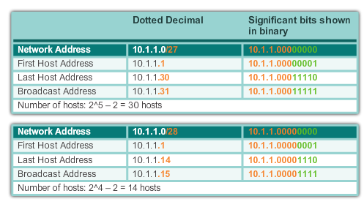
IPv4 Subnet Mask Examining the Prefix Length (cont.)
Notes:
8.1.2.2 Examining the Prefix Length (cont.)

Slide 12
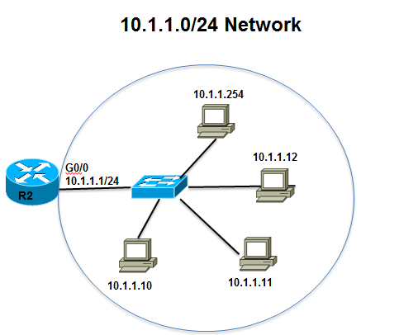
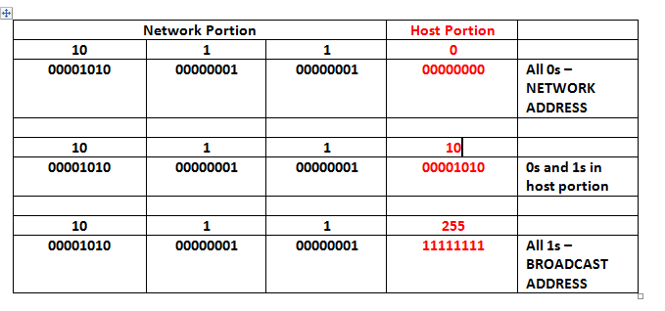
IPv4 Subnet Mask IPv4 Network, Host, and Broadcast Address
10.1.1.0/24
Notes:
8.1.2.3 IPv4 Network, Host and Broadcast Address

Slide 13
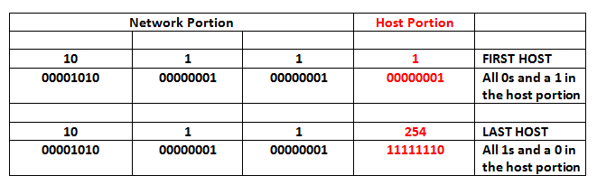
IPv4 Subnet Mask First Host and Last Host Addresses
10.1.1.0/24
Notes:
8.1.2.4 First Host and Last Host Addresses

Slide 14
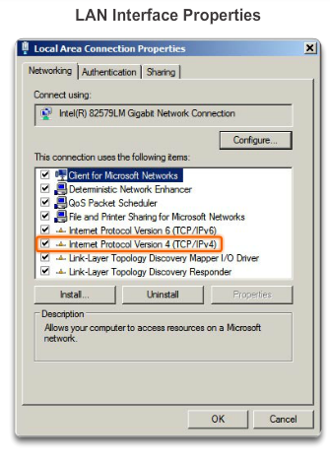
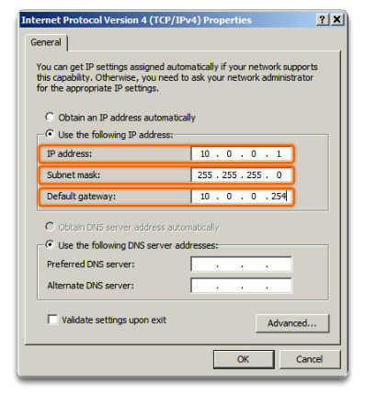
IPv4 Unicast, Broadcast, and Multicast Assigning a Static IPv4 Address to a Host
LAN Interface Properties
Configuring a Static IPv4 Address
Notes:
8.1.3.1 Assigning a Static IPv4 Address to a Host

Slide 15
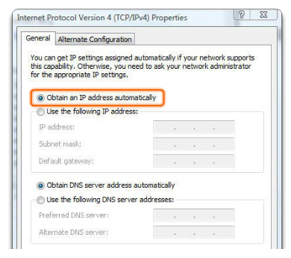
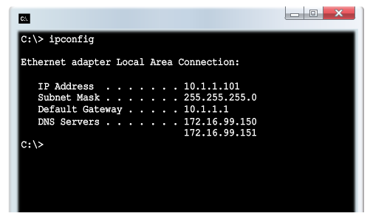
IPv4 Unicast, Broadcast, and Multicast Assigning a Dynamic IPv4 Address to a Host
Verification
DHCP – The preferred method of assigning IPv4 addresses to hosts on large networks because it reduces the burden on network support staff and virtually eliminates entry errors.
Notes:
8.1.3.2 Assigning a Dynamic IPv4 Address to a Host

Slide 16
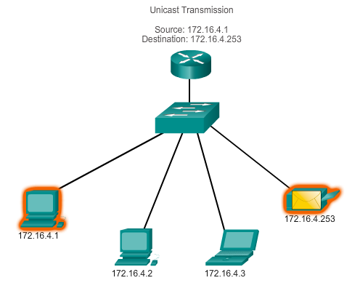
IPv4 Unicast, Broadcast, and Multicast Unicast Transmission
In an IPv4 network, the hosts can communicate one of three different ways:
Unicast, Broadcast, and Multicast
#1 Unicast – the process of sending a packet from one host to an individual host.
Notes:
8.1.3.3 Unicast Transmission

Slide 17
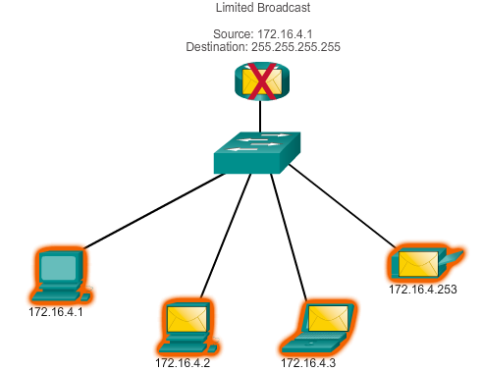
IPv4 Unicast, Broadcast, and Multicast Broadcast Transmission
In an IPv4 network, the hosts can communicate one of three different ways: Unicast, Broadcast, and Multicast.
#2 Broadcast – the process of sending a packet from one host to all hosts in the network.
Directed broadcast
Destination 172.16.4.255
Hosts within the 172.16.4.0/24 network
NOTE: Routers do not forward a limited broadcast!
Directed broadcast
Destination 172.16.4.255
Hosts within the 172.16.4.0/24 network
Notes:
8.1.3.4 Broadcast Transmission

Slide 18
IPv4 Unicast, Broadcast, and Multicast Multicast Transmission
In an IPv4 network, the hosts can communicate one of three different ways: Unicast, Broadcast, and Multicast.
#3 Multicast – The process of sending a packet from one host to a selected group of hosts, possibly in different networks.
Reserved for addressing multicast groups – 224.0.0.0 to 239.255.255.255.
Link local – 224.0.0.0 to 224.0.0.255 (Example: routing information exchanged by routing protocols)
Notes:
8.1.3.5 Multicast Transmission

Slide 19
Types of IPv4 Address Public and Private IPv4 Addresses
Private address blocks are:
Hosts that do not require access to the Internet can use private addresses
10.0.0.0 to 10.255.255.255 (10.0.0.0/8)
172.16.0.0 to 172.31.255.255 (172.16.0.0/12)
192.168.0.0 to 192.168.255.255 (192.168.0.0/16)
Shared address space addresses:
Not globally routable
Intended only for use in service provider networks
Address block is 100.64.0.0/10
Notes:
8.1.4.1 Public and Private IPv4 Addresses

Slide 20
Types of IPv4 Address Special Use IPv4 Addresses
Network and Broadcast addresses – within each network the first and last addresses cannot be assigned to hosts
Loopback address – 127.0.0.1 a special address that hosts use to direct traffic to themselves (addresses 127.0.0.0 to 127.255.255.255 are reserved)
Link-Local address – 169.254.0.0 to 169.254.255.255 (169.254.0.0/16) addresses can be automatically assigned to the local host
TEST-NET addresses – 192.0.2.0 to 192.0.2.255 set aside for teaching and learning purposes, used in documentation and network examples
Experimental addresses – 240.0.0.0 to 255.255.255.254 are listed as reserved
Notes:
8.1.4.3 Special Use IPv4 Addresses

Slide 21
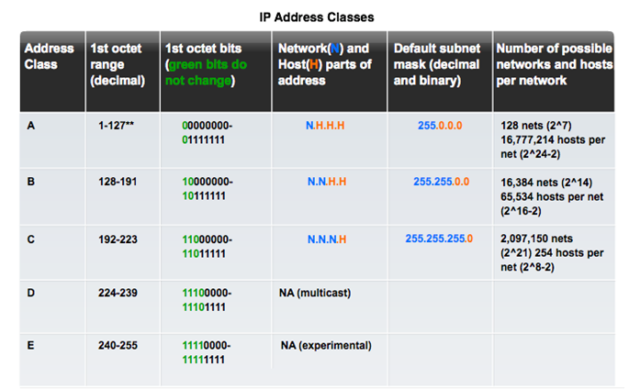
Types of IPv4 Address Legacy Classful Addressing
See if updated graphic with top row in text case for consistency.
Notes:
8.1.4.4 Legacy Classful Addressing

Slide 22
Types of IPv4 Address Classless Addressing
Formal name is Classless Inter-Domain Routing (CIDR)
Created a new set of standards that allowed service providers to allocate IPv4 addresses on any address bit boundary (prefix length) instead of only by a class A, B, or C address
Notes:
8.1.4.4 Legacy Classful Addressing (cont.)

Slide 23

Types of IPv4 Address Assignment of IP Addresses
Regional Internet Registries (RIRs)
Notes:
8.1.4.5 Assignment of IP Addresses

Slide 24
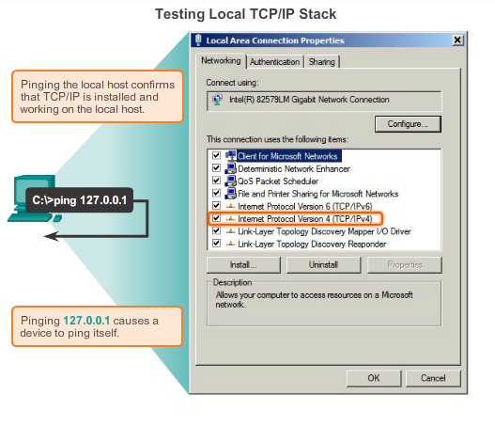
Testing and Verification Ping – Testing the Local Stack
Notes:
8.3.2.1 Ping – Testing the Local Stack

Slide 25
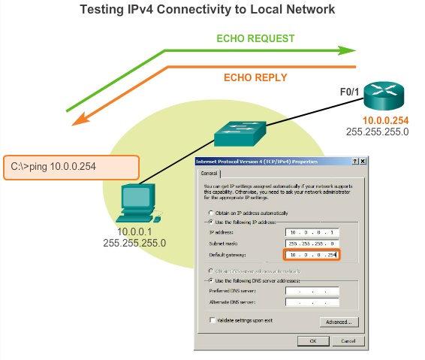
Testing and Verification Ping – Testing Connectivity to the Local LAN
Notes:
8.3.2.2 Ping – Testing Connectivity to the Local LAN

Slide 26
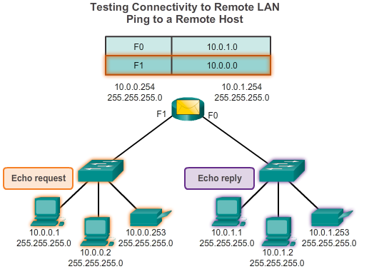
Testing and Verification Ping – Testing Connectivity to Remote
Notes:
8.3.2.3 Ping – Testing Connectivity to Remote

Slide 27
Testing and Verification Traceroute – Testing the Path
Traceroute
Generates a list of hops that were successfully reached along the path.
Provides important verification and troubleshooting information.
If the data reaches the destination, then the trace lists the interface of every router in the path between the hosts.
If the data fails at some hop along the way, the address of the last router that responded to the trace can provide an indication of where the problem or security restrictions are found.
Provides round-trip time for each hop along the path and indicates if a hop fails to respond.
Notes:
8.3.2.4 Traceroute – Testing the Path

Slide 28
Subnetting an IPv4 Network
Notes:
9.1 Subnetting an IPv4 Network

Slide 29
Network Segmentation Reasons for Subnetting
Subnetting is the process of segmenting a network into multiple smaller network spaces called subnetworks or subnets.
Large networks must be segmented into smaller subnetworks, creating smaller groups of devices and services to:
Control traffic by containing broadcast traffic within each subnetwork.
Reduce overall network traffic and improve network performance.
Communication Between Subnets
A router is necessary for devices on different networks and subnets to communicate.
Each router interface must have an IPv4 host address that belongs to the network or subnet that the router interface is connected.
Devices on a network and subnet use the router interface attached to their LAN as their default gateway.
Notes:
9.1.1.1 Reasons for Subnetting
9.1.1.2 Communication Between Subnets

Slide 30
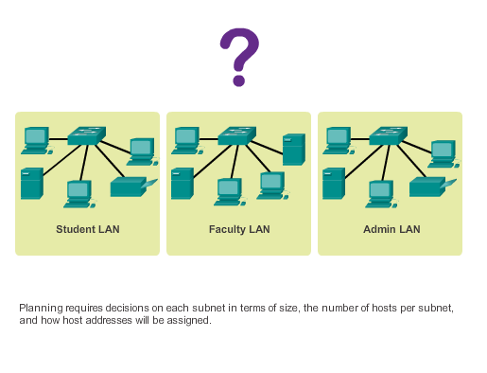
IP Subnetting is FUNdamental The Plan
Planning the Network
Notes:
9.1.2.1 The Plan
9.1.2.2 The Plan - Address Assignment

Slide 31
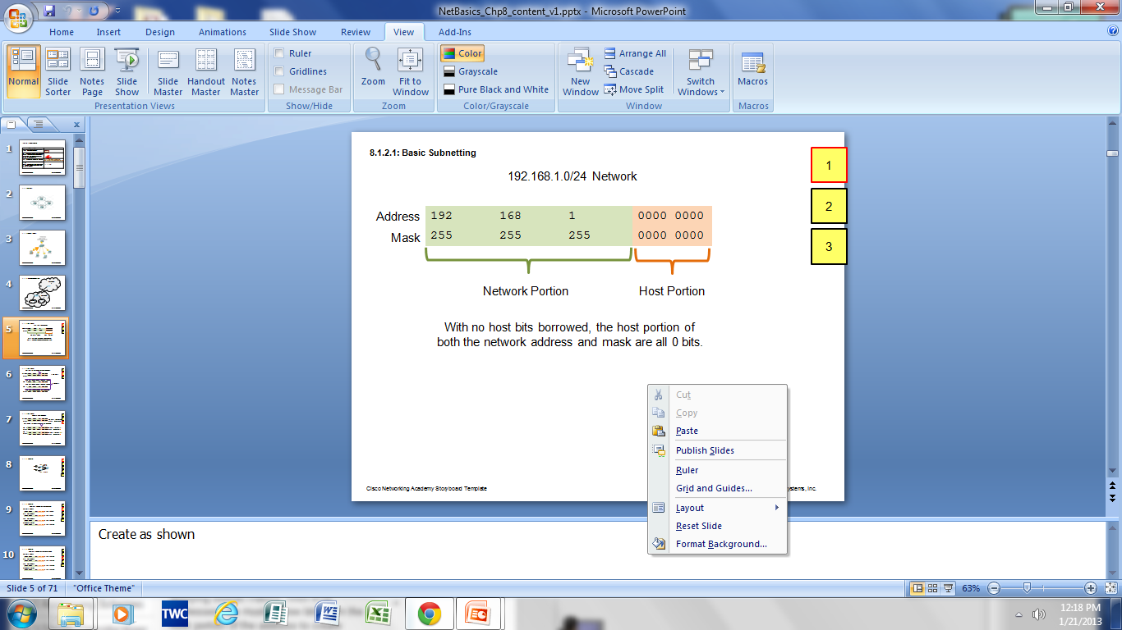
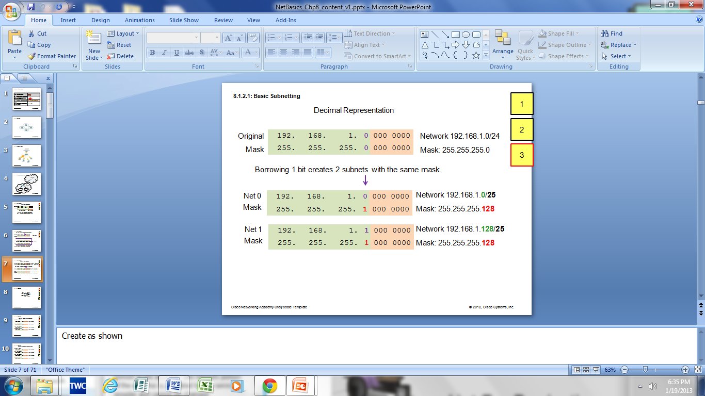
Subnetting an IPv4 Network Basic Subnetting
Borrowing Bits to Create Subnets
Borrowing 1 bit 2¹ = 2 subnets
Borrowing 1 Bit from the host portion creates 2 subnets with the same subnet mask
Subnet 0
Network 192.168.1.0-127/25
Mask: 255.255.255.128
Subnet 1
Network 192.168.1.128-255/25
Mask: 255.255.255.128
Notes:
9.1.3.1 Basic Subnetting

Slide 32
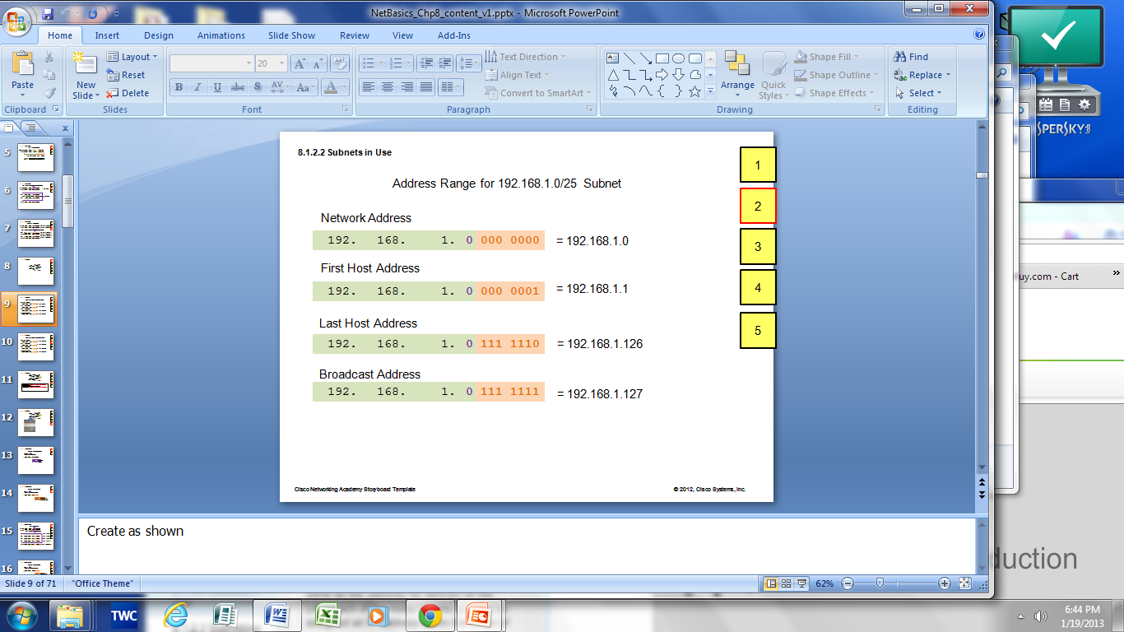
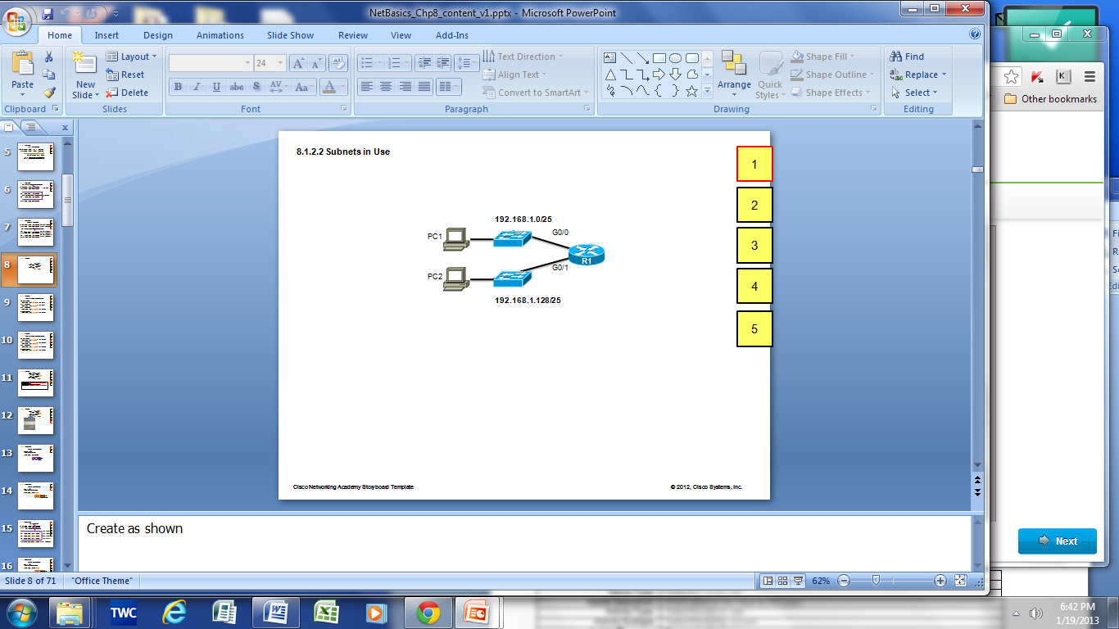

Subnetting an IPv4 Network Subnets in Use
Subnets in Use
Subnet 0
Network 192.168.1.0-127/25
Subnet 1
Network 192.168.1.128-255/25
Notes:
9.1.3.2 Subnets in Use

Slide 33
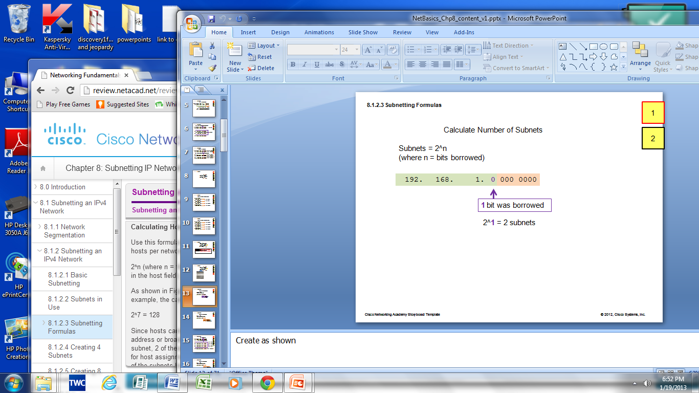
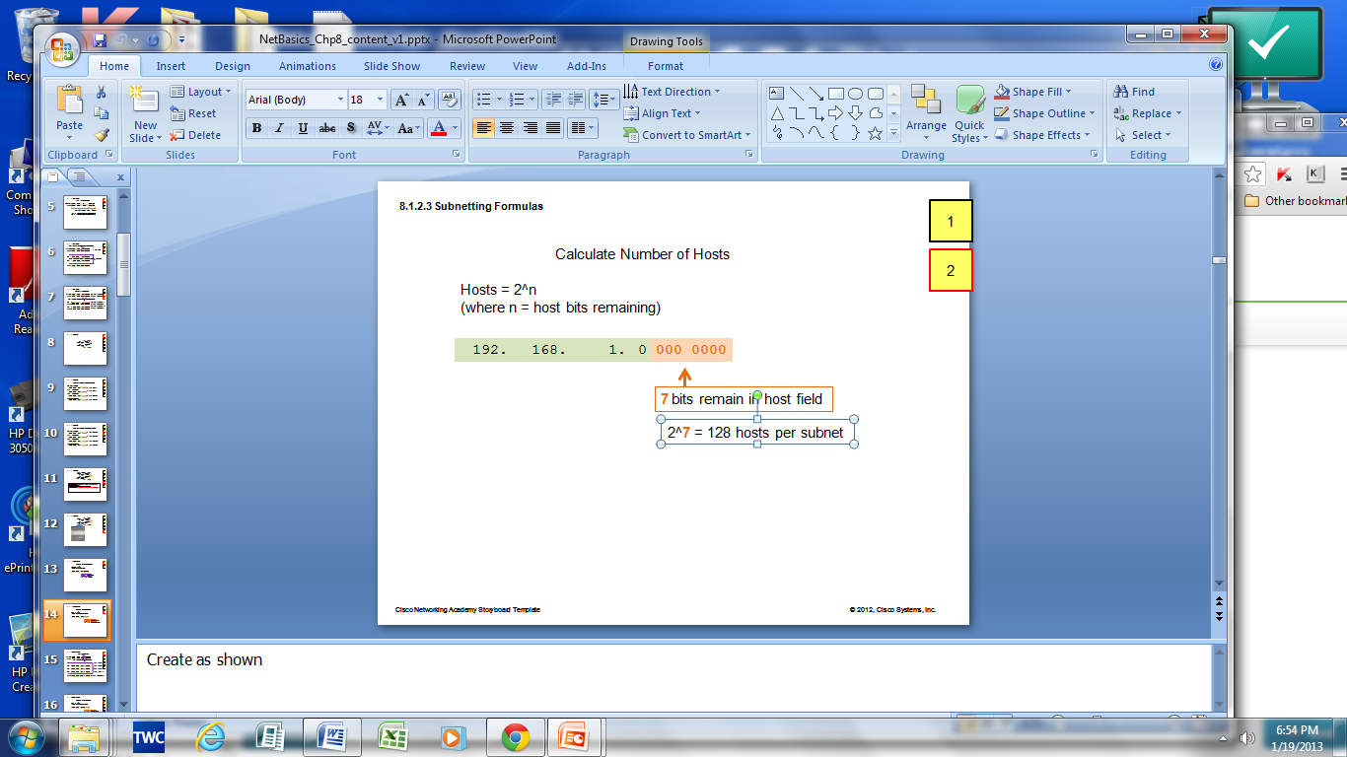
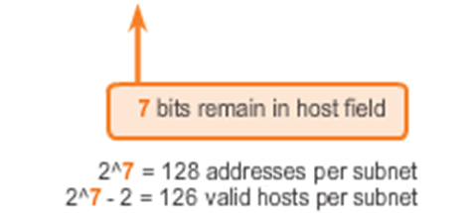
Subnetting an IPv4 Network Subnetting Formulas
Calculate number of subnets
Calculate number of hosts
Notes:
9.1.3.3 Subnetting Formulas

Slide 34
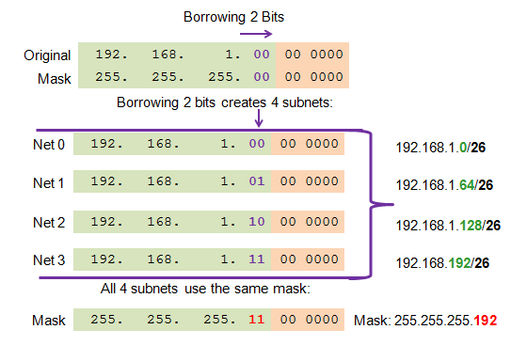
Subnetting an IPv4 Network Creating 4 Subnets
Borrowing 2 bits to create 4 subnets. 2² = 4 subnets
Creating 4 Subnets
Notes:
9.1.3.4 Creating 4 subnets

Slide 35
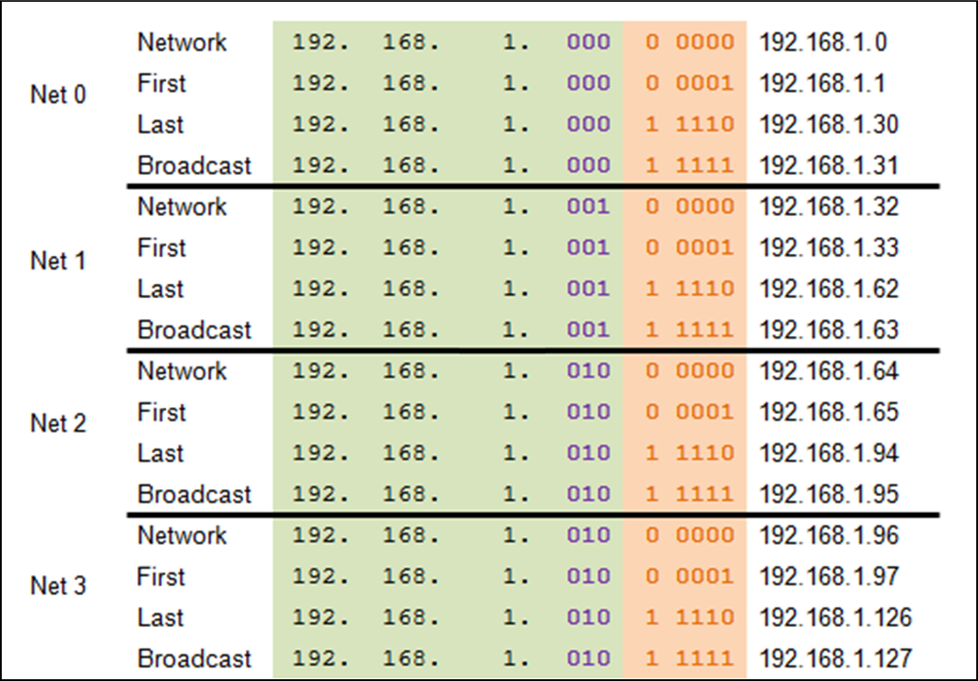
Subnetting an IPv4 Network Creating Eight Subnets
Borrowing 3 bits to Create 8 Subnets. 2³ = 8 subnets
Notes:
9.1.3.5 Creating 8 subnets

Slide 36
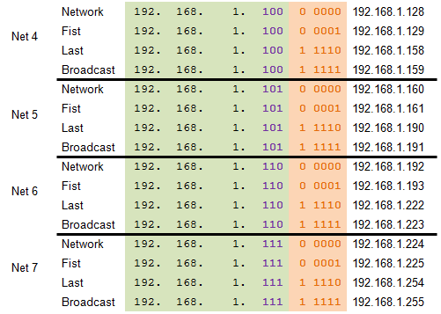
Subnetting an IPv4 Network Creating Eight Subnets (Cont.)
Notes:
9.1.3.5 Creating 8 Subnets (Cont.)

Slide 37
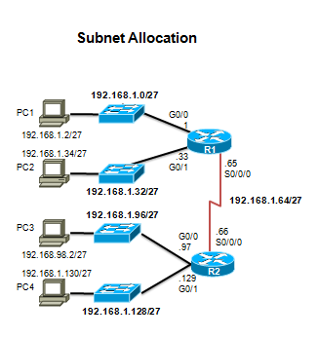
Subnetting an IPv4 Network Creating Eight Subnets (Cont.)
Notes:
9.1.3.5 Creating 8 Subnets (Cont.)

Slide 38
Determining the Subnet Mask Subnetting Based on Host Requirements
Two considerations when planning subnets:
Number of subnets required
Number of host addresses required
Formula to determine number of usable hosts: 2^n-2
2^n (where n is the number of remaining host bits) is used to calculate the number of hosts.
-2 (The subnetwork ID and broadcast address cannot be used on each subnet.)
Notes:
9.1.4.1 Subnetting based on Host Requirements

Slide 39
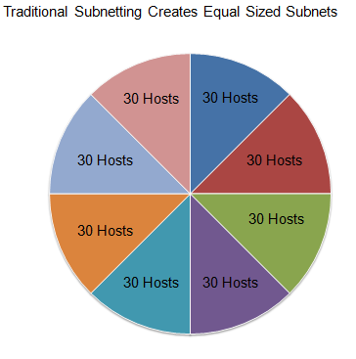
Benefits of Variable Length Subnet Masking Traditional Subnetting: Equal Addresses
Subnets that require fewer addresses have unused (wasted) addresses
For example, WAN links only need two addresses.
Notes:
9.1.4.1 Traditional Subnetting Wastes Addresses

Slide 40
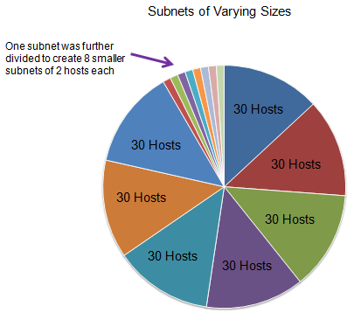
Benefits of Variable Length Subnet Masking Variable Length Subnet Masks (VLSM)
The variable-length subnet mask (VLSM) or subnetting a subnet provides more efficient use of addresses.
VLSM allows a network space to be divided in unequal parts.
Subnet mask varies, depending on how many bits have been borrowed for a particular subnet.
Network is first subnetted, and then the subnets are resubnetted.
Notes:
9.1.4.2 Variable Length Subnet Masks (VLSM)

Slide 41
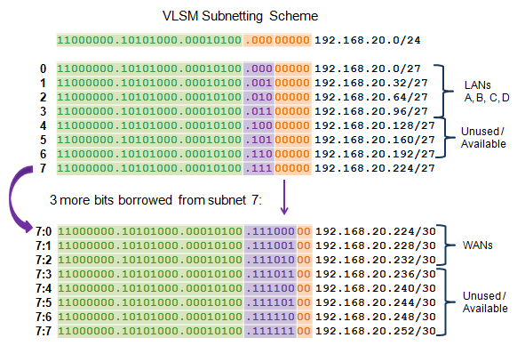
Benefits of Variable Length Subnet Masking Basic VLSM
Notes:
9.1.5.3 Basic VLSM

Slide 42
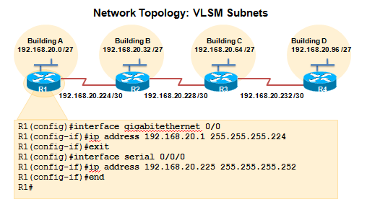
Benefits of Variable Length Subnet Masking VLSM in Practice
Using VLSM subnets, the LAN and WAN segments in example below can be addressed with minimum waste.
Each LANs will be assigned a subnet with /27 mask.
Each WAN link will be assigned a subnet with /30 mask.
Notes:
9.1.5.4 VLSM in Practice

Slide 43
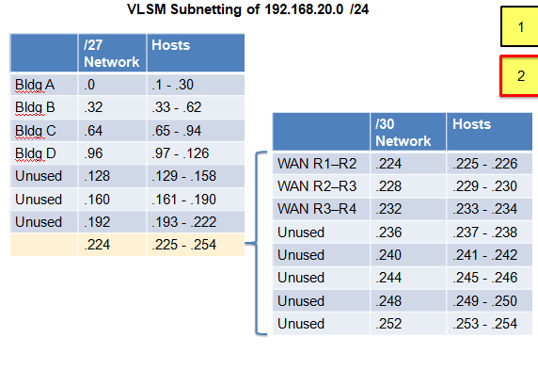
Benefits of Variable Length Subnet Masking VLSM Chart
Notes:
9.1.5.5 VLSM Chart

Slide 44
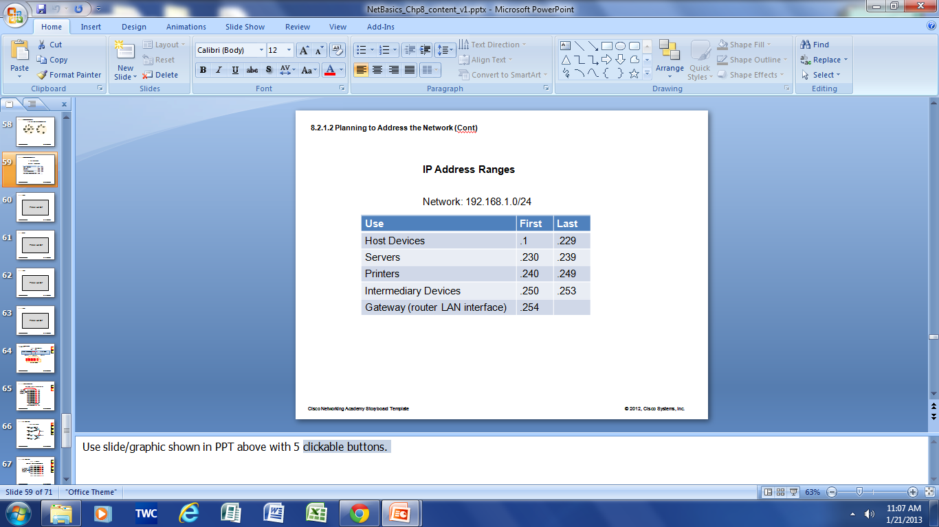
Structured Design Planning to Address the Network
Allocation of network addresses should be planned and documented for the purposes of:
Preventing duplication of addresses
Providing and controlling access
Monitoring security and performance
Client addresses – Usually dynamically assigned using the Dynamic Host Configuration Protocol (DHCP).
Sample Network Addressing Plan
Notes:
9.2.1.1 Planning to Address the Network
9.2.1.2 Assigning Addresses to Devices

Slide 45
9.3 Design Considerations for IPv6
Notes:
9.3 Design Considerations for IPv6

Slide 46
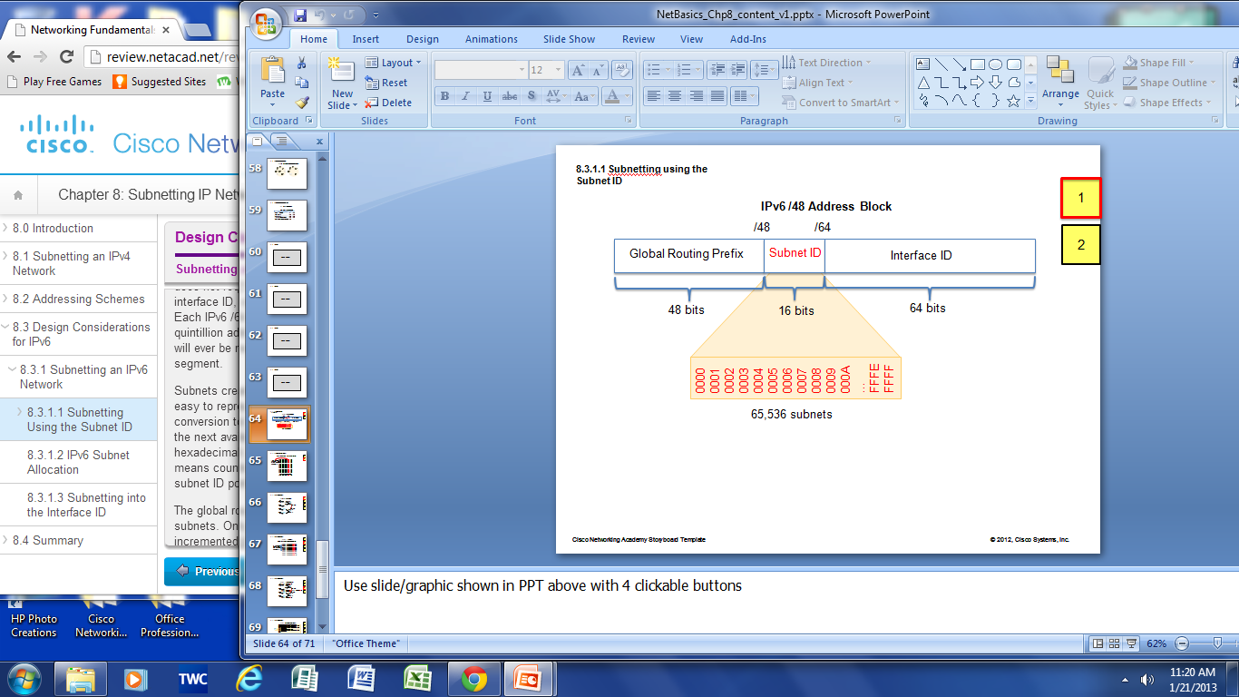
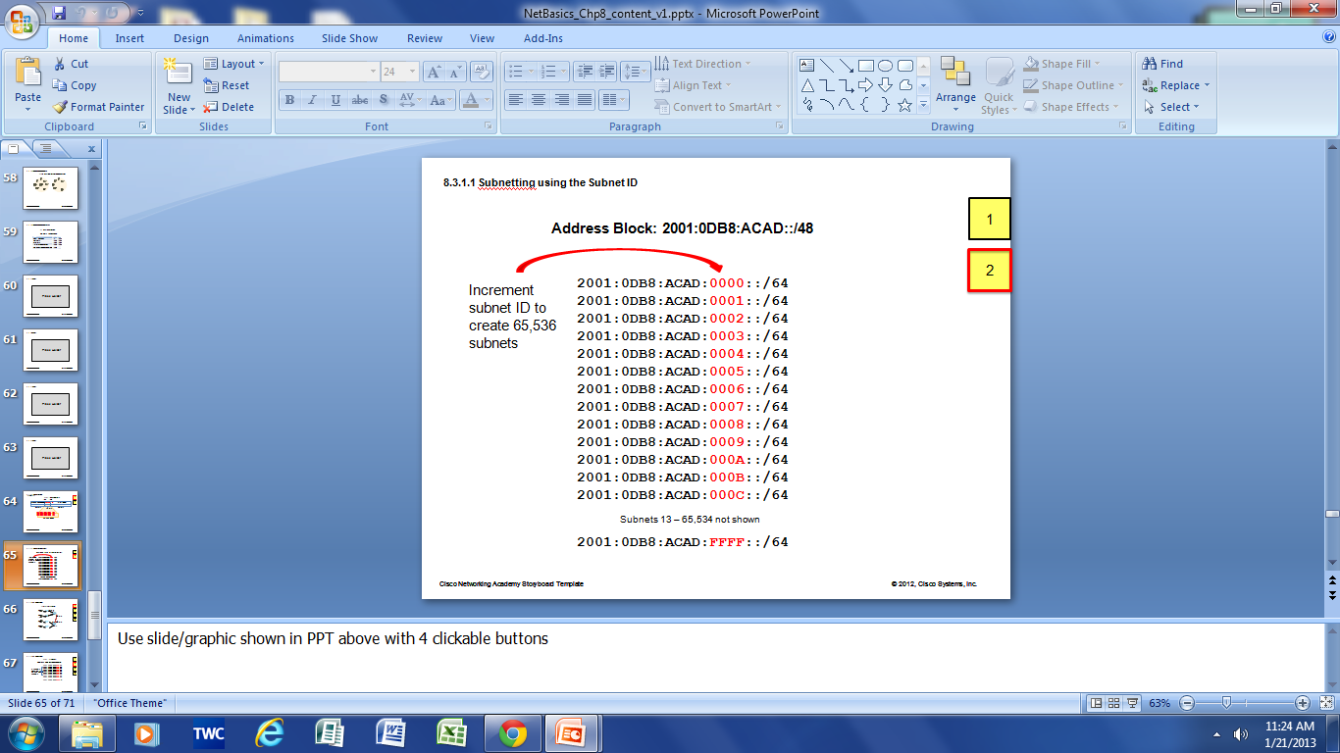
Subnetting an IPv6 Network Subnetting Using the Subnet ID
An IPv6 Network Space is subnetted to support hierarchical, logical design of the network
Notes:
9.3.1.1 Subnetting Using the Subnet ID

Slide 47
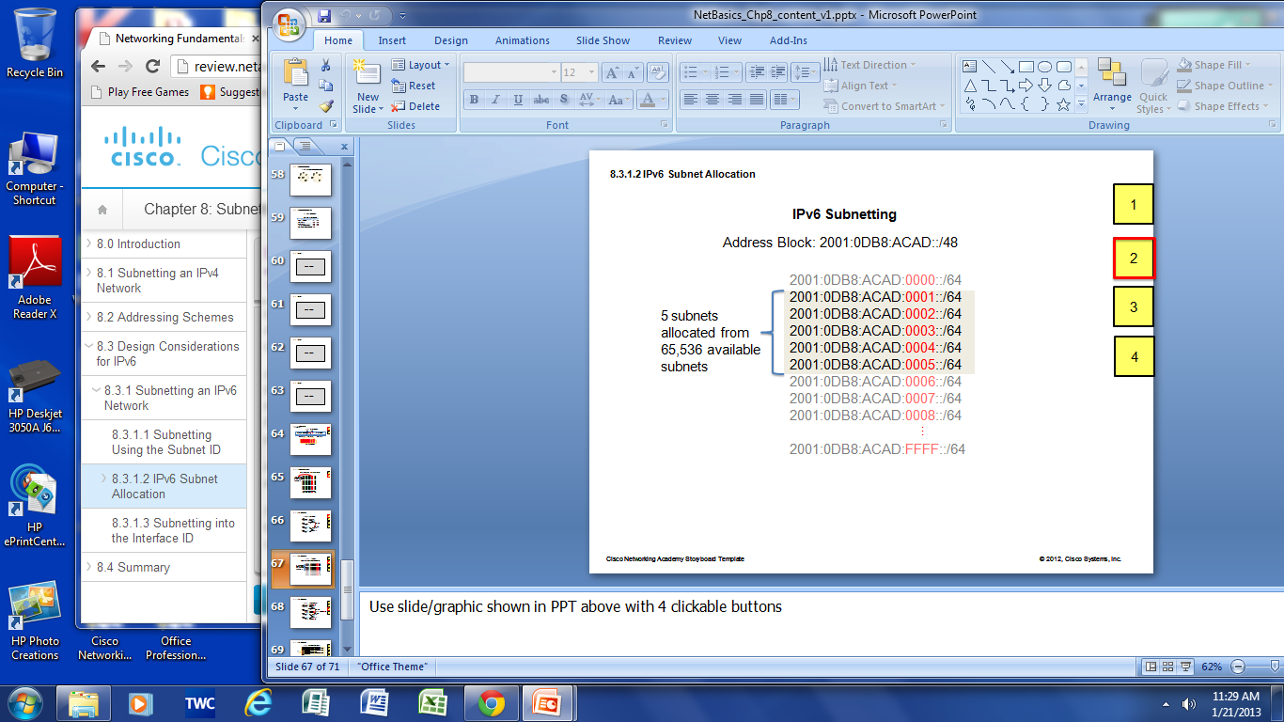
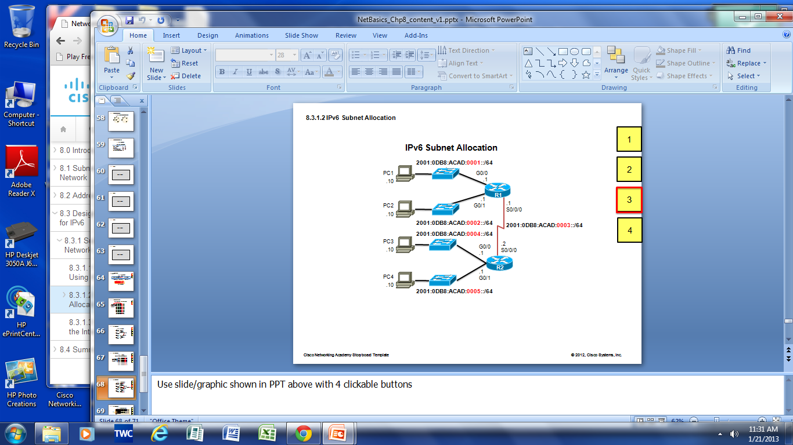
Subnetting an IPv6 Network IPV6 Subnet Allocation

